Slide 1
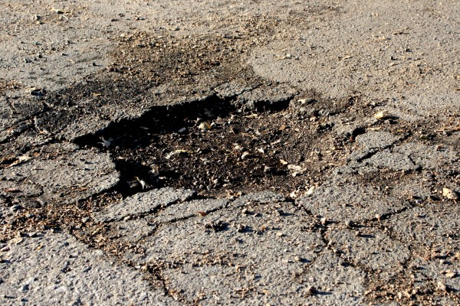
POTHOLE ANALYSIS in THE CITY OF Chicago
Melanie Hanna
July 2017

Slide 2
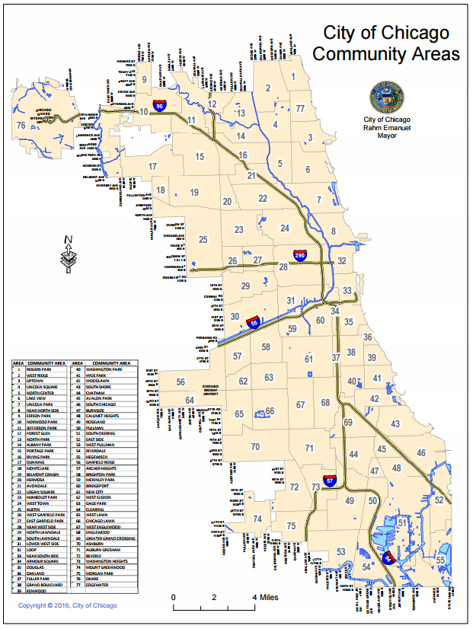
Introduction
We set out to:
Analyze pothole data across all 77 community areas in the city of Chicago
Compare to census data to discover patterns in demographic/economic variables
Create predictive models to forecast pothole metrics for a given geographic area

Slide 3
Data sets
City of Chicago’s 311 Service Request database from January 2011 to June 2017
More than 477,000 pothole reports
Includes creation and completion date, number of potholes found on block when crew arrives, physical address of request
Chicago Metropolitan Agency for Planning (CMAP)’s Community Snapshot data:
77 community areas
Sourced from U.S. Census Bureau's 2010-14 American Community Survey, Longitudinal Employment-Household Dynamics data for 2014, and 2014/2015 data from the Illinois Department of Employment Security and the Illinois Department of Revenue
155 metrics in total (median income, percent vacant housing, etc.)

Slide 4
Data exploration

Slide 5
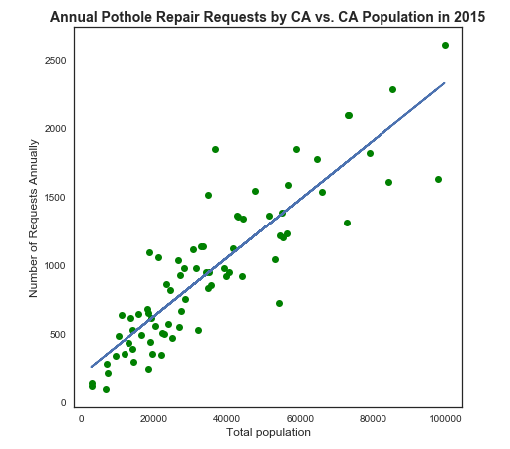
Service requests by community area
Linear relationship between total population and the annual number of pothole repair requests
Slope of regression line indicates 2.1 requests are submitted per 100 residents, regardless of community area

Slide 6
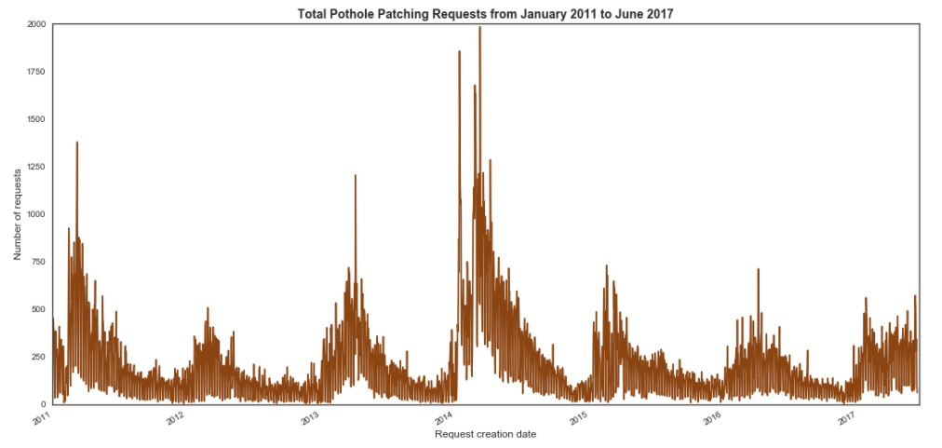
Service requests over time
Spike in requests in early 2014 aligns with winter vortex
Regular increase in springtime months
43.5% of all requests occur in spring

Slide 7
Pothole metrics vs. census data
Analyzed relationships between the following:
Pothole metrics
Number of potholes found by the DoT per block
Number of annual pothole repair requests
Response time to repair request
Census data
Median income
Percent of land defined as roadways
Commuting transportation method (public transit, carpool, etc.)
Percent of land as commercial
Percent of land as residential
Percent of land as industrial

Slide 8
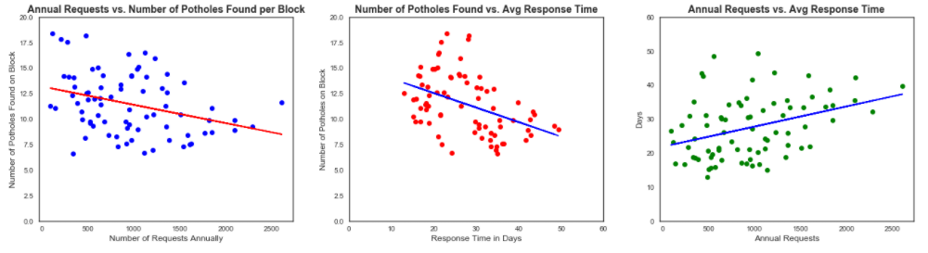
Pothole metrics vs. census data
Correlations found between all three pothole metrics:
Number of potholes found is negatively correlated with both response time and annual requests
Fewer potholes are discovered with more frequent and prompt service
Response time is positively correlated with annual requests
DoT does not respond as quickly to CA’s filing more repair requests OR CA’s file more repair requests when the DoT responds slowly

Slide 9
Other relationships found
As median income , annual repair requests
As median income , number of potholes found
As percent of land zoned as residential , annual requests
Tied to correlation with total population
As percent of land zoned as commercial , annual requests
As percent of land zoned as commercial , response time
As percent of land zoned as commercial , number of potholes found

Slide 10
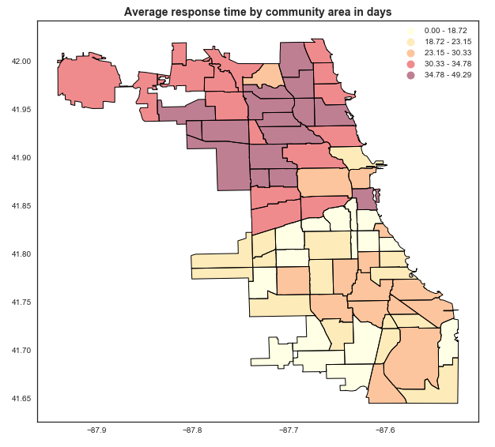
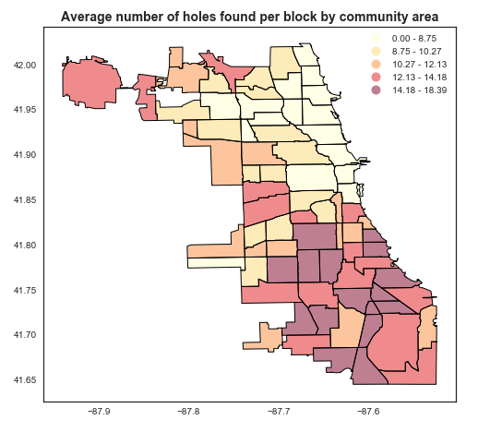
North vs. South
Southern community areas typically see more potholes per block than northern areas
Southern average: 13.1 holes
Northern average: 9.0 holes
Northern areas wait longer on average for pothole repair than southern community areas
Southern average: 21.1 days
Northern average: 36.4 days

Slide 11
PREDictive models

Slide 12
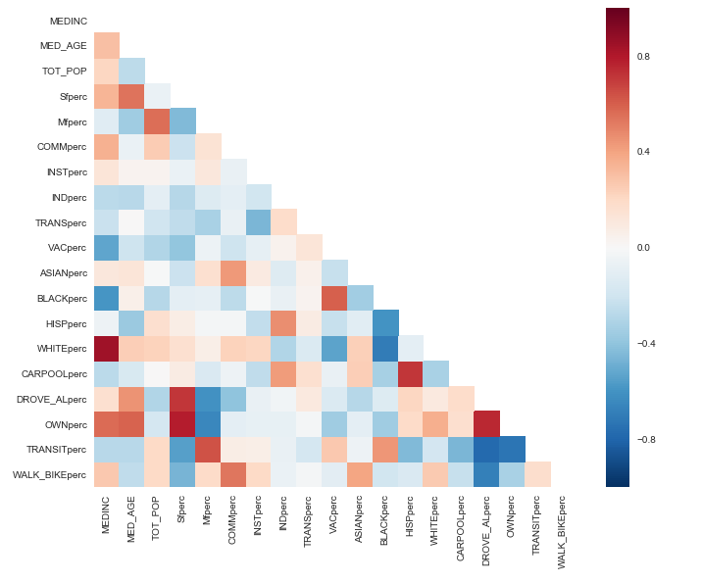
Linear regression
Selected 19 features from the census data covering:
Median age
Median income
Race
Mode of transport for commuting
Percent of land used as industrial, commercial, residential, & transportation
Percent of owner-occupied housing
Correlation matrix shows some relationships but none strong enough to skew the model

Slide 13
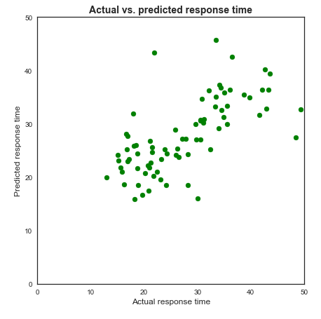
Linear regression on response time
Model explains 37% of the variance in the data – a moderate value for fit
Large increase in error from training set to test data, indicating an overfit model that does not generalize well
Linear regression is not a good choice for this data set

Slide 14
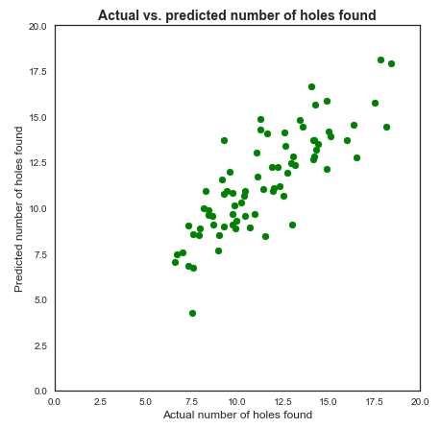
Linear regression on number of holes
Model explains 65% of the variance in the data – a much better fit than the response model
Small error on both training and test data
Linear regression models the number of holes found per block very well

Slide 15
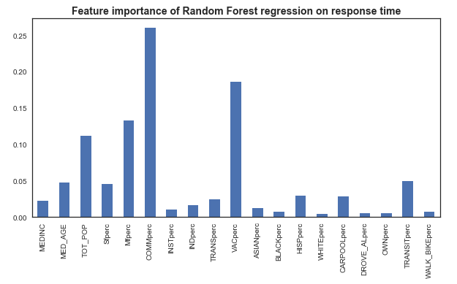
Random tree regression on response time
Model explains 89% of data’s variance but does not generalize well to the test set
Percentage of land zoned as commercial and percent of vacant land are most important features during training

Slide 16
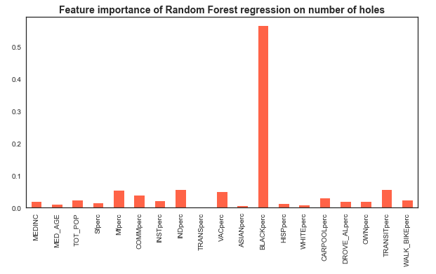
Random tree regression on number of holes
Model explains 90% of the variance in the data
Error on the training and test set is remarkably low
Percentage of black residents is by far the most important feature

Slide 17
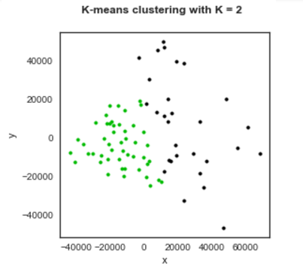
Clustering
Combined census features from regression models and pothole data into one dataset and reduced to 2 dimensions
Trained clustering model around 2 clusters to explore north-south relationships in community areas
Cluster 1: 12 northern CA’s and 2 southern ones
Cluster 2: 5 northern CA's and 27 southern ones
Clustering model then applied to test data
Cluster 1: 3 northern CA's and 0 southern ones
Cluster 2: 0 northern CA's and 15 southern ones
Very accurate generalization

Slide 18
Recommendations and future work
Use censusreporter.org to gather census data on smaller geographies
For the City:
Conduct a study to determine the root cause of the north/south divide in 311 service request response time
For Chicago residents:
Lobby your alderman if your community area has a longer than average response time for pothole repair requests or if a large number of potholes are expected per block in your neighborhood.
Plot your daily commute to determine if those streets are pothole-ridden and route a new course on smoother roads.

